Slide 1
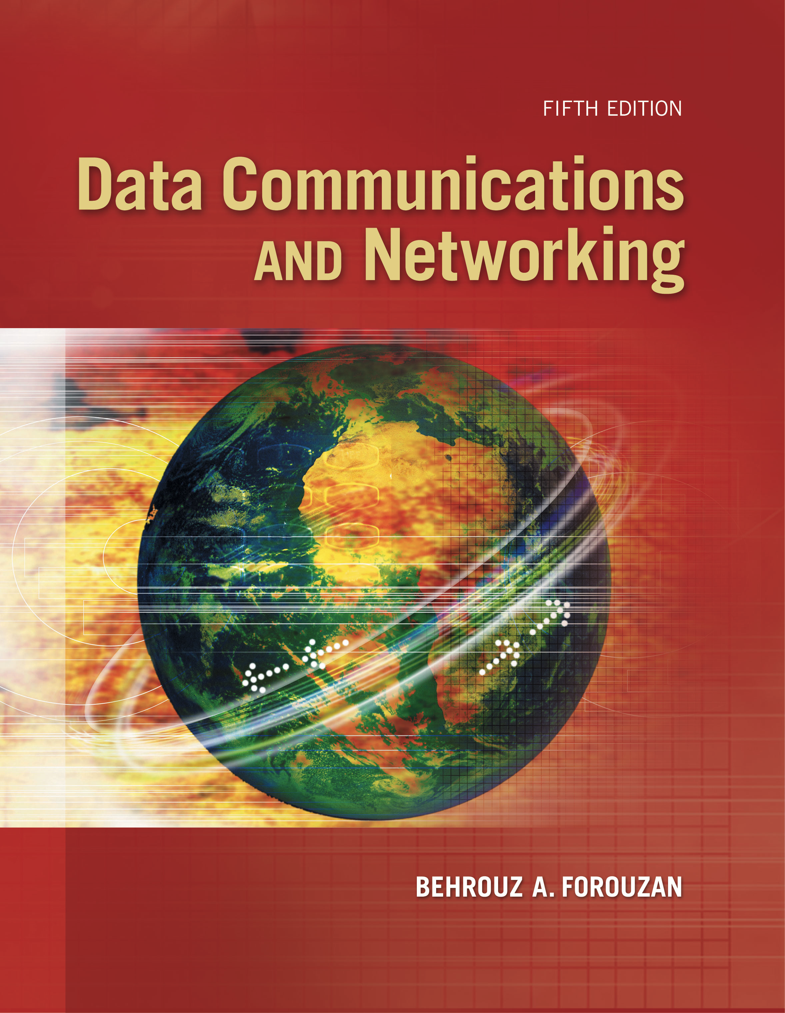
Computer Networks
Bluetooth Technology & Connecting Device
S.V.Jansi Rani
Associate Professor / CSE

Slide 2
AGENDA
Bluetooth
Architecture
Bluetooth Layers
Single and Multiple Secondary Communication
Frame Format
Radio Layer
Connecting Devices
Hub, switch & Router

Slide 3



Slide 4
BLUETOOTH

Slide 5
BLUETOOTH
Bluetooth is a wireless LAN technology designed to connect devices of different functions when they are at a short distance from each other.
A Bluetooth LAN is an ad hoc network.
The devices, sometimes called gadgets, find each other and make a network called a piconet.
Bluetooth (IEEE 802.15) cannot be large

Slide 6
Architecture
Bluetooth defines two types of networks: piconet and scatternet.
Piconet - 8 stations
Parked state and active state
Device - 1 Mbps with a 2.4-GHz bandwidth

Slide 7
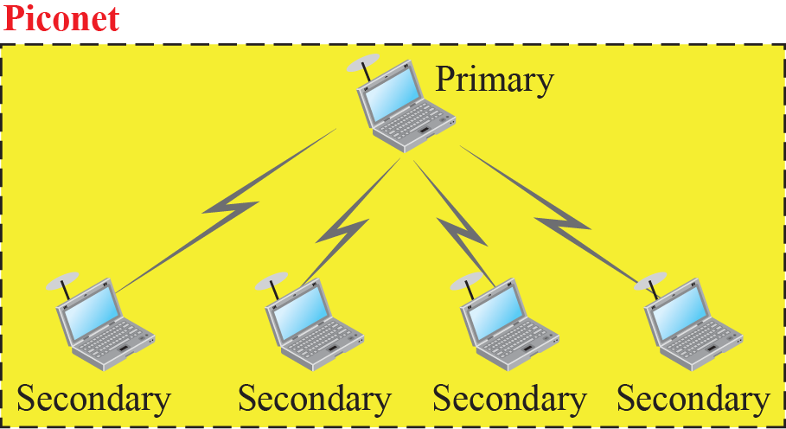
Piconet

Slide 8
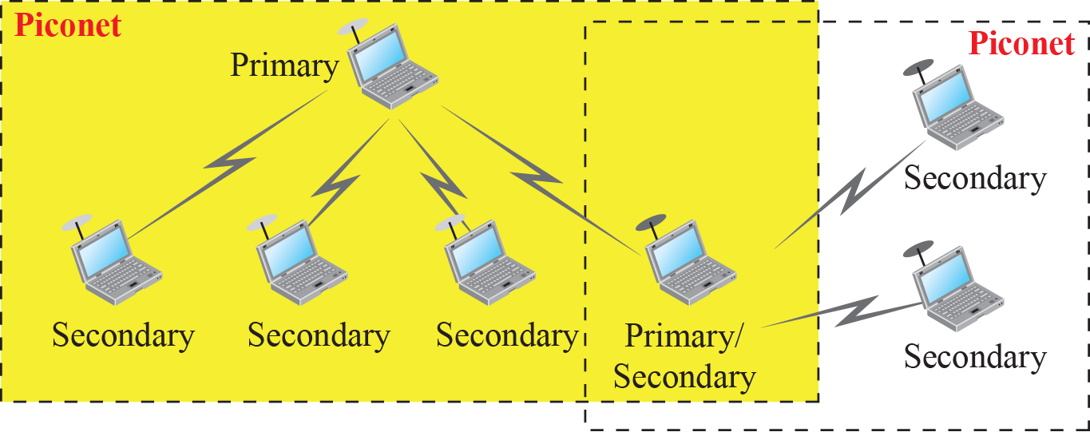
Scatternet

Slide 9
Bluetooth Layers
Bluetooth uses several layers that do not exactly match those of the Internet model

Slide 10
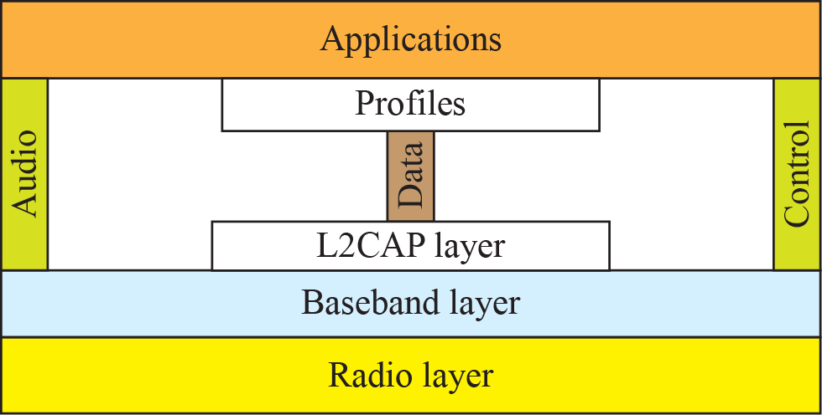
Bluetooth layers

Slide 11
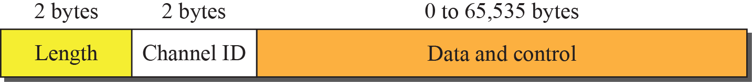
L2CAP data packet format

Slide 12
L2CAP
The L2CAP has specific duties: multiplexing, segmentation and reassembly, quality of service (QoS), and group management.
Multiplexing
Accepts data from UL -frames -delivers
Receiver site - accepts a frame from the baseband layer -extracts the data –delivers to appropriate protocol layer.

Slide 13
L2CAP
Segmentation and Reassembly
Maximum size of the payload field in the baseband layer is 2774 bits, or 343 bytes.
Size of the packet - 339 bytes (excluding 4 bytes header
Need to send a data packet that can be up to 65,535 bytes
L2CAP divides these large packets into segments
L2CAP segments the packets at the source and reassembles them at the destination.

Slide 14
L2CAP
QOS
Best effort service
Group Management
Another functionality -allow devices to create a type of logical addressing between themselves.
This is similar to multicasting.
For example, two or three secondary devices can be part of a multicast group to receive data from the primary.

Slide 15
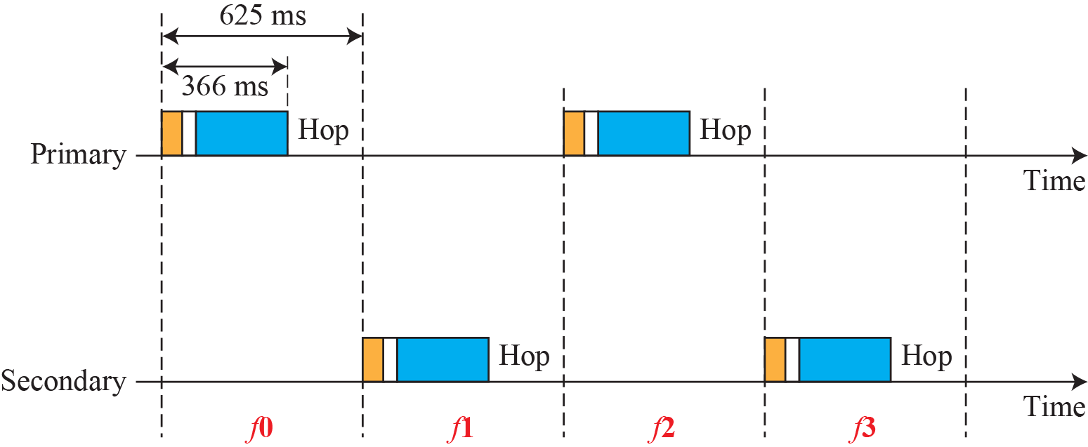
Single-secondary communication

Slide 16
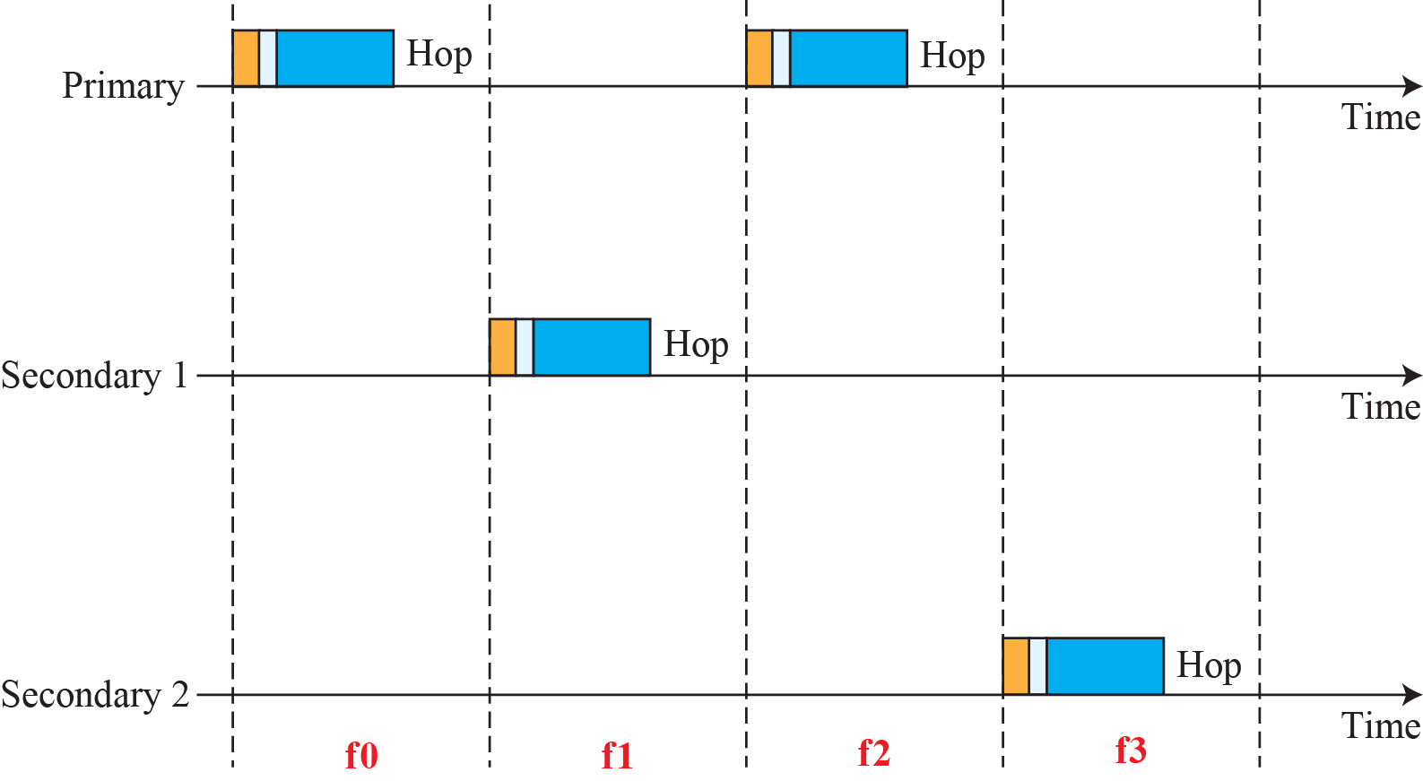
Multiple-secondary communication

Slide 17
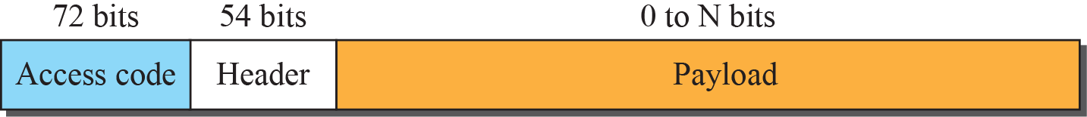
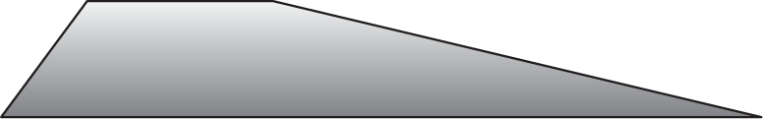
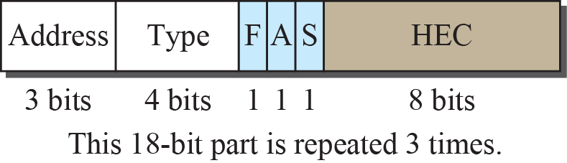
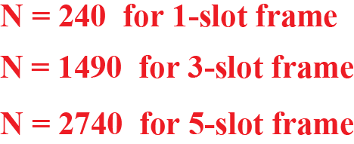
Frame format types

Slide 18
Radio Layer
The radio layer is roughly equivalent to the physical layer of the Internet model.
Bluetooth devices are low-power and have a range of 10 m.
Band
Bluetooth uses a 2.4-GHz ISM band divided into 79 channels of 1 MHz each.
FHSS
Bluetooth hops 1600 times per second, which means that each device changes its modulation frequency 1600 times per second.
A device uses a frequency for only 625 μs (1/1600 s) before it hops to another frequency; the dwell time is 625 μs.

Slide 19
Radio Layer
Modulation
Bluetooth uses a sophisticated version of FSK, called
GFSK (FSK with Gaussian bandwidth filtering).
GFSK has a carrier frequency. Bit 1 is represented by a frequency deviation above the carrier; bit 0 is represented by a frequency deviation below the carrier.
The frequencies, in megahertz, are defined according to the following formula for each channel.
F_{c} = 2402 + n MHz , n = 0,1,2 3….,78
For example, the first channel uses carrier frequency 2402 MHz (2.402 GHz)
second channel uses carrier frequency 2403 MHz (2.403 GHz).

Slide 20
Connecting Devices

Slide 21
Connecting Devices
Hosts and networks do not normally operate in isolation.
Connecting devices to connect hosts together to make a network or to connect networks together to make an internet.
Connecting devices can operate in different layers of the Internet model.
Three kinds of connecting devices:
Hubs
Link-layer switches
Routers

Slide 22
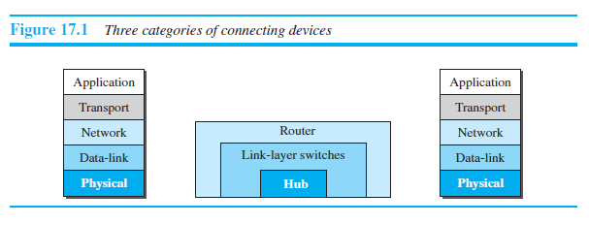
Connecting Devices

Slide 23
Hub
Hub -physical layer
Signals that carry information within a network can travel a fixed distance before attenuation endangers the integrity of the data.
A repeater receives a signal and, before it becomes too weak or corrupted,
regenerates and retimes the original bit pattern.
The repeater then sends the refreshed signal.
Ethernet LANs -bus topology - repeater
Ethernet LANs - star topology- repeater is a multiport device : hub-connecting & as a repeater

Slide 24
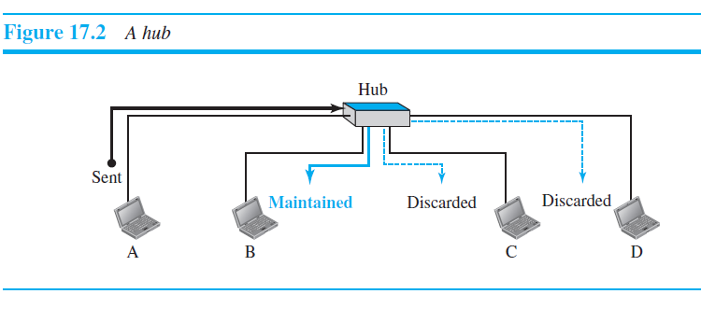
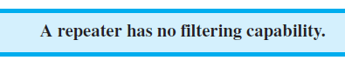
Hub

Slide 25
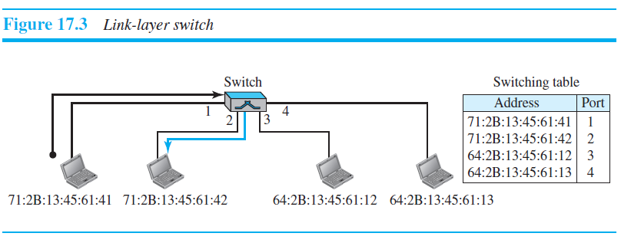
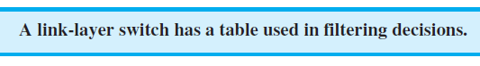
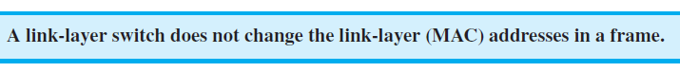
Link layer Switch
It has filtering capability.
It can check the destination address of a frame and can decide from which outgoing port the frame should be sent.

Slide 26
Transparent Switch
A transparent switch is a switch in which the stations are completely unaware of the switch’s existence.
If a switch is added or deleted from the system, reconfiguration of the stations is unnecessary.
A system equipped with transparent switches must meet three criteria:
❑ Frames must be forwarded from one station to another.
❑ The forwarding table is automatically made by learning frame movements in the
network.
❑ Loops in the system must be prevented.
Forwarding
A transparent switch must correctly forward the frames

Slide 27
Transparent Switch
Learning
The switching tables –static- manual entry during switch setup.
If a station was added or deleted / MAC address changed, the table had to be modified manually.
Solution: Dynamic table that maps addresses to ports (interfaces) automatically.
To make a table dynamic, we need a switch that gradually learns from the frames’ movements.

Slide 28
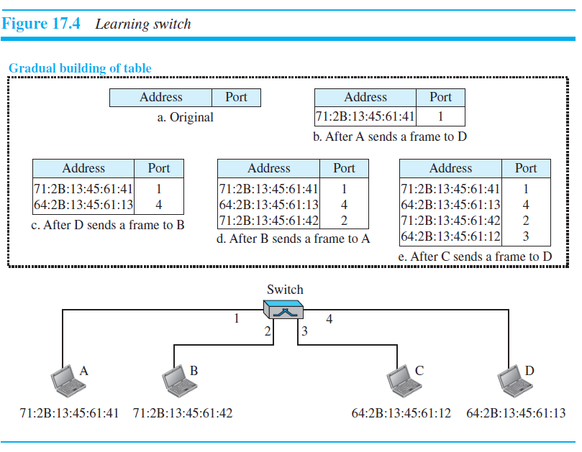
Transparent Switch

Slide 29
Transparent Switch
Loop Problem
Redundant switches (more than one switch between a pair of LANs) to make the system more reliable.
Redundancy can create loops in the system - two or more broadcasting LANs are connected by more than one switch.

Slide 30
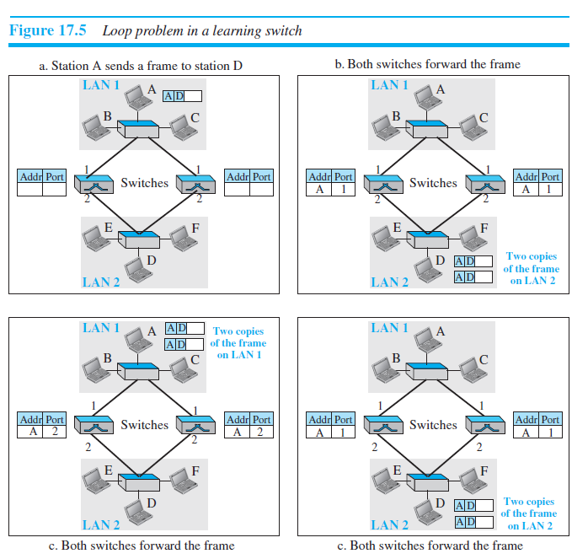

Slide 31
Spanning Tree Algorithm
The process for finding the spanning tree involves three steps:
1. Every switch has a built-in ID (normally the serial number, which is unique). Each
switch broadcasts this ID so that all switches know which one has the smallest ID.
The switch with the smallest ID is selected as the root switch (root of the tree).
2. The algorithm tries to find the shortest path (a path with the shortest cost) from the root switch to every other switch or LAN. The shortest path can be found by examining the total cost from the root switch to the destination-Dijkstra algorithm
3. The combination of the shortest paths creates the shortest tree
4. Based on the spanning tree, we mark the ports that are part of it, the forwarding
ports, which forward a frame that the switch receives. We also mark those ports
that are not part of the spanning tree, the blocking ports, which block the frames
received by the switch.

Slide 32
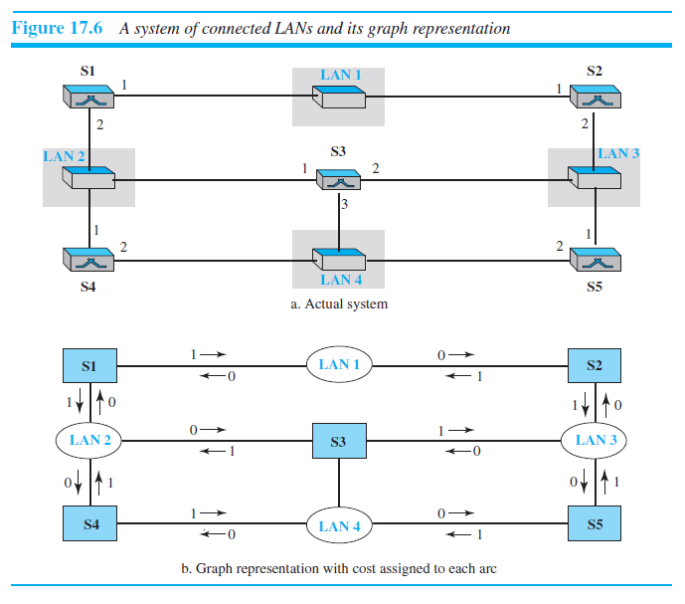

Slide 34
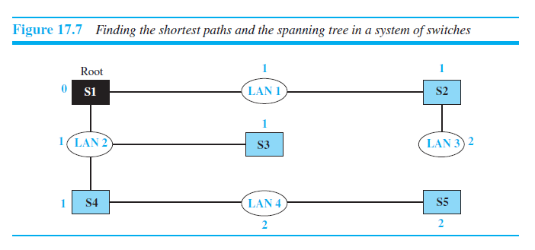

Slide 35
Advantages of Switches
A link-layer switch has several advantages over a hub.
Collision Elimination
Connecting Heterogenous Devices

Slide 36
Router
A router is a three-layer device; it operates in the physical, data-link, and network layers.
As a physical-layer device, it regenerates the signal it receives. As a link-layer device, the router checks the physical addresses (source and destination) contained in the packet. As a network-layer device, a router checks the network-layer addresses.
A router can connect networks.
Router is an internetworking device;
It connects independent networks to form an internetwork.
Two networks connected by a router become an internetwork or an internet.
There are three major differences between a router and a repeater or a switch.
1. A router has a physical and logical (IP) address for each of its interfaces.
2. A router acts only on those packets in which the link-layer destination address
matches the address of the interface at which the packet arrives.
3. A router changes the link-layer address of the packet (both source and destination)
when it forwards the packet.

Slide 37
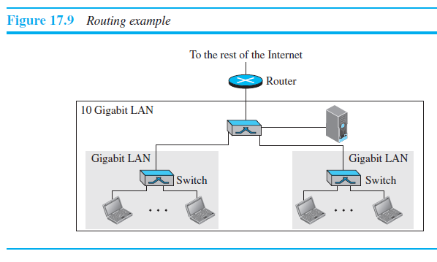
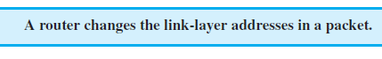
Router

Slide 38
Check Your Understanding
What is the basic unit of bluetooth
Which flow control protocol is used in Bluetooth?

Slide 39
Outcome
Student should be able to
Explain the Bluetooth technology

Slide 40
THANK YOU

